Slide 1
SOFTWARE ENGINEERING
Under the guidance of
Dr. Fahad sir

Slide 2
LEAVE MANAGEMENT SYSTEM

Slide 3
TEAM MEMBERS
2110030054
VAISHNAVI
2110030203
MANISRI
NAVYA
2110030218
2110030233
RISHIKA

Slide 4
PROBLEM STATEMENT
In the existing system, leaves are maintained using the attendance register for staff. The staff needs to submit their leaves manually to their respective authorities. This increases the paperwork & maintaining the records becomes tedious. Maintaining notices in the records also increases the paperwork.
Adjusting shedules for employee leaves based on the provider preferences for leave application.

Slide 5
PURPOSED ALGORITHM DESIGN TECHNIQUE
What is the technique
The objective of this project is to create a system where the employee can easily apply for their leave through online system
How is it suitable for your application
Leave permits you to take time off from work for legitimate reasons, all with the formal approval of your supervisors through online.
Register:
Login:
Leave applies:
Live review:
Leave approval:
Log out:

Slide 6
EXISTING SOLUTIONS:
Our system is comprised of few important interface or we can say modules behind it so here we will discuss the modules related to all those interfaces and workflow further.
A leave management system is a software solution that automates the time-off process, helping companies to stay compliant with labor laws and be more productive. It also helps employees request their own leave by providing them access through an online portal, so they can track it themselves too!

Slide 7
DATA SET COLLECTIONS
A data structure is a specialized format for organizing , processing retrieving and storing data.
There are several basic and advanced types of data structures ,all designed to arrange data for a use of purpose.
The main methods are
Files
Strings

Slide 8
TOOLS REQUIRED
We will be using different software's to achieve the desired outcome
Which are as below :
Frontend
Django through PyCharm
Backend
Star UML
MySQL
HTML

Slide 9
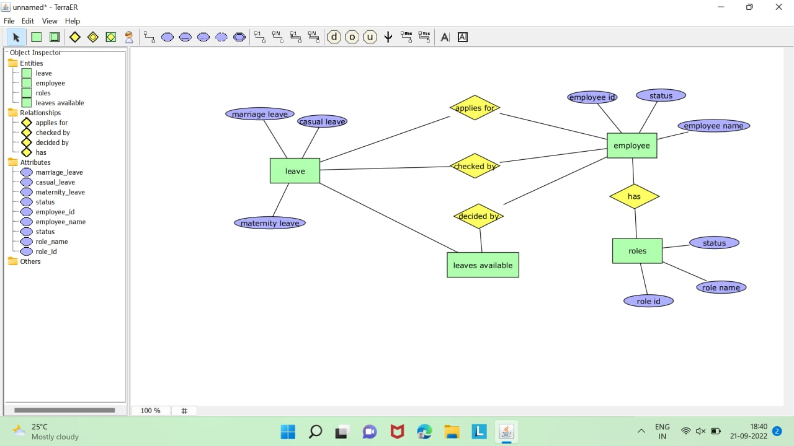
ER DIAGRAM

Slide 10
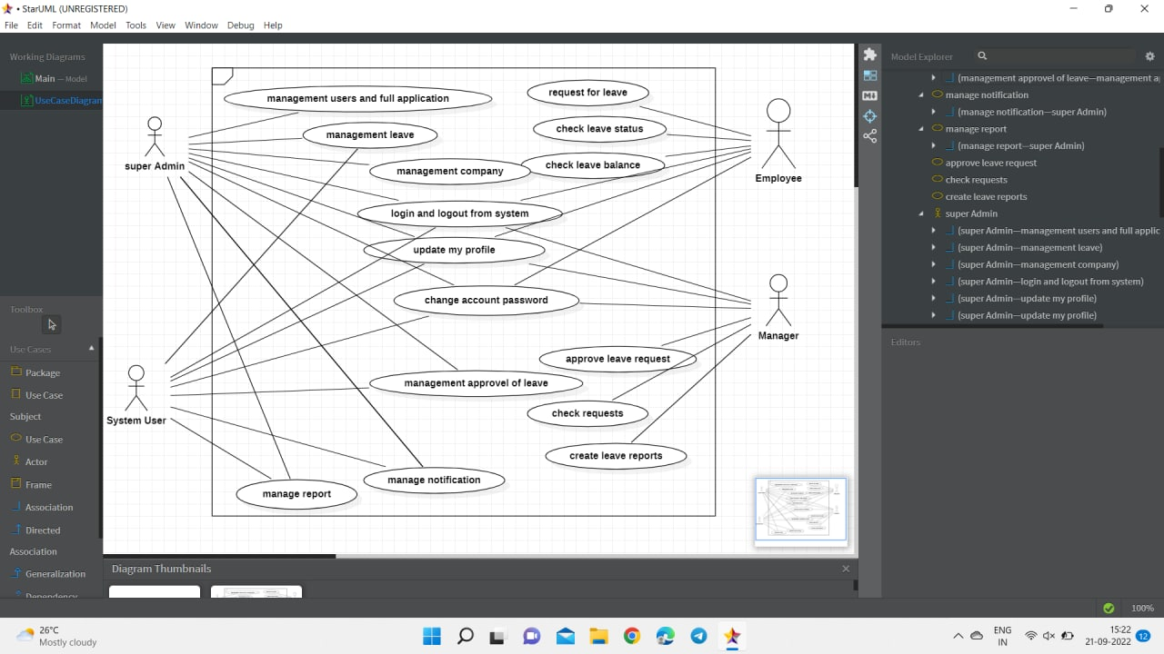
USE CASE DIAGRAM

Slide 11
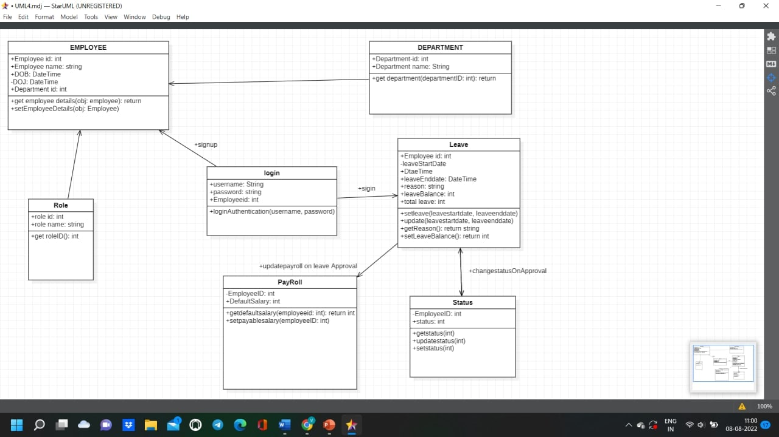
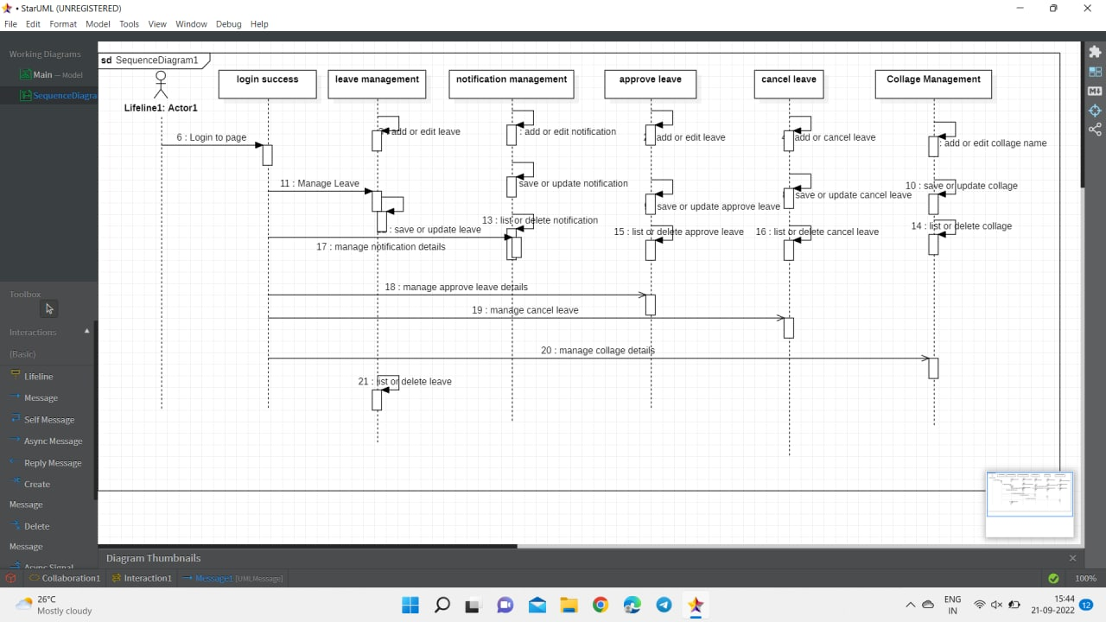
CLASS DIAGRAM
SEQUENCE DIAGRAM

Slide 12
FLOW CHART
Start
login
yes
successful
No
Check leave application
Approve/reject leave applications
Update record
Send email notification
stop

Slide 13
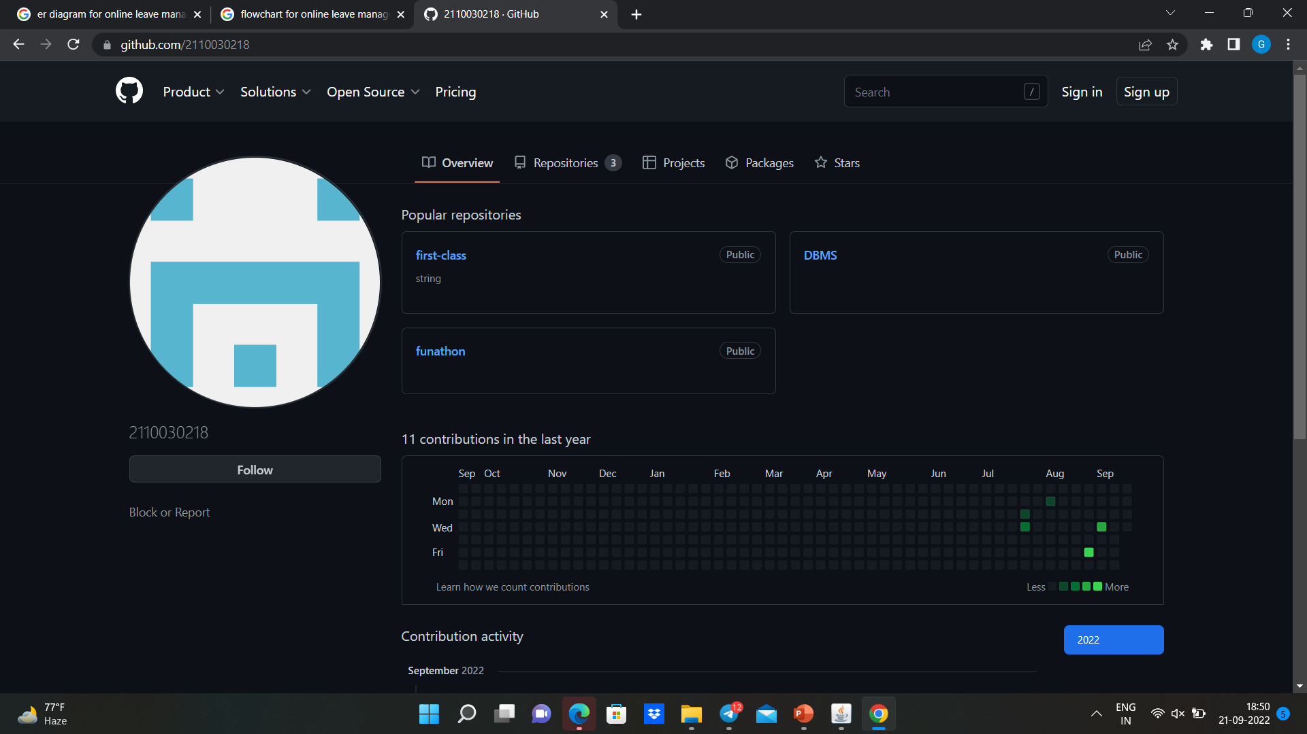
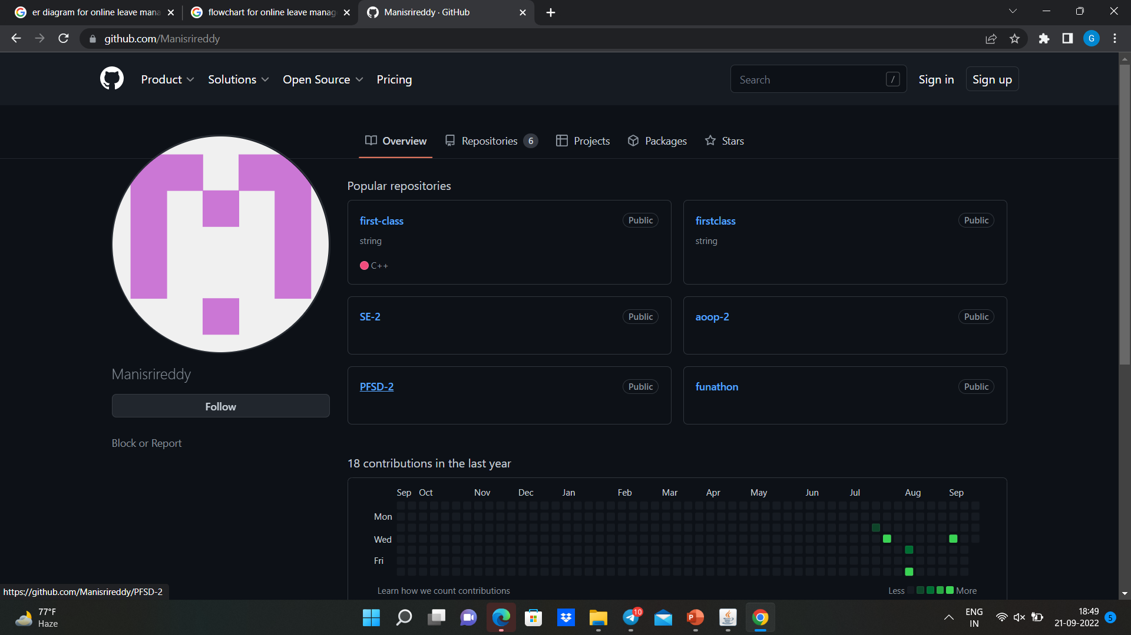
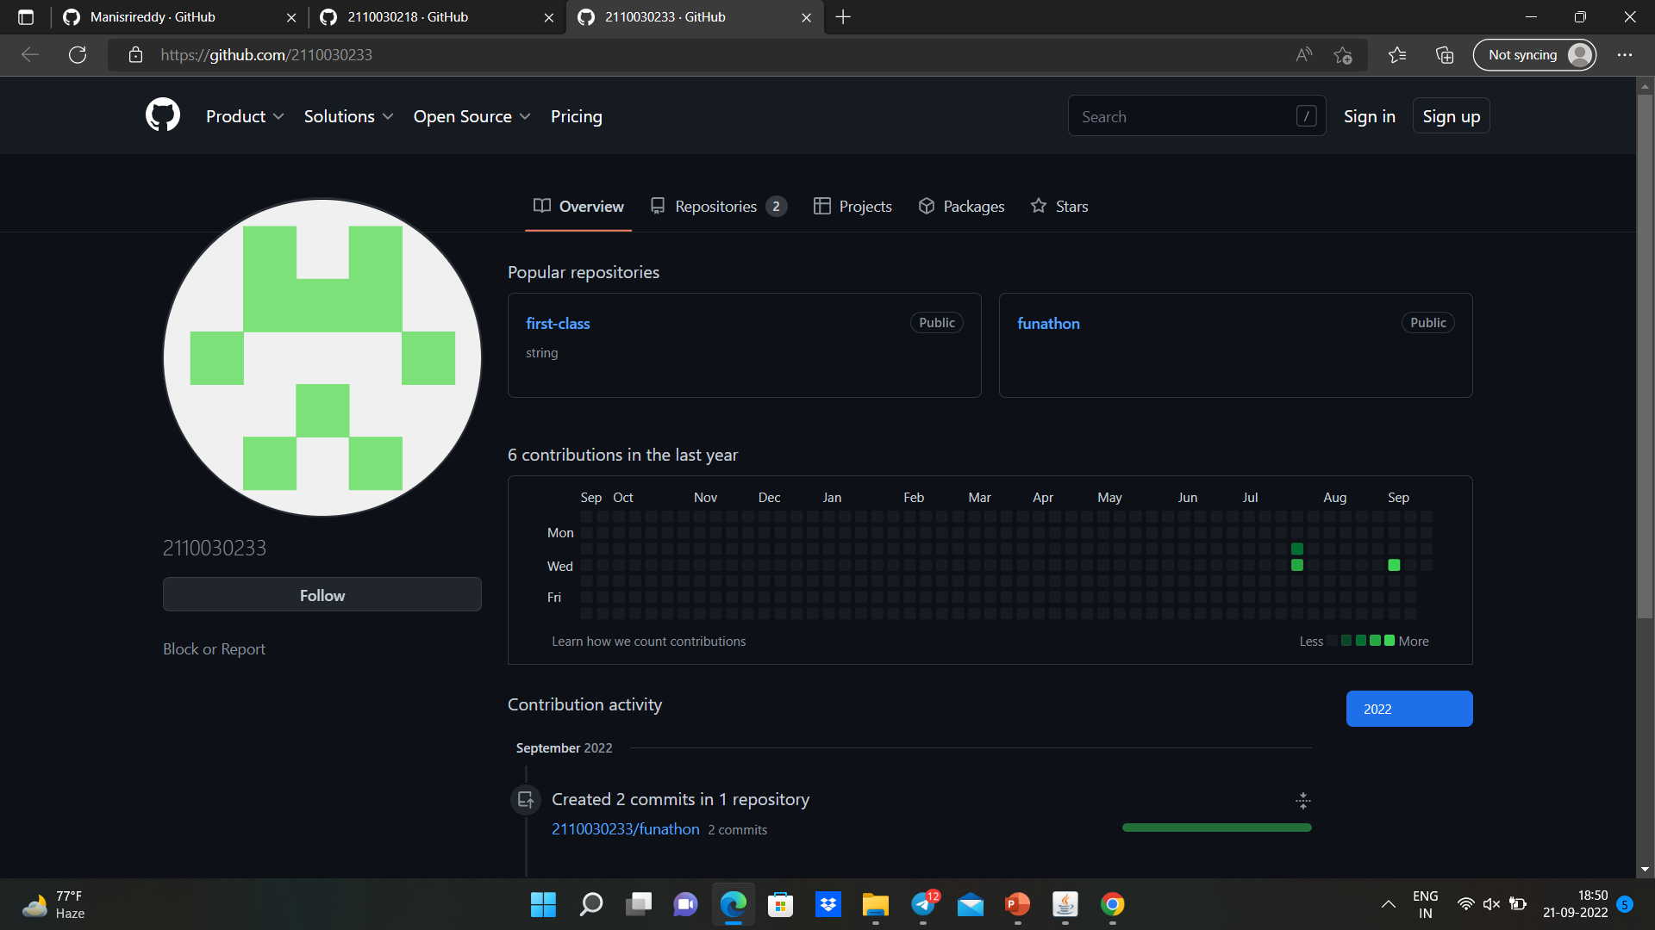
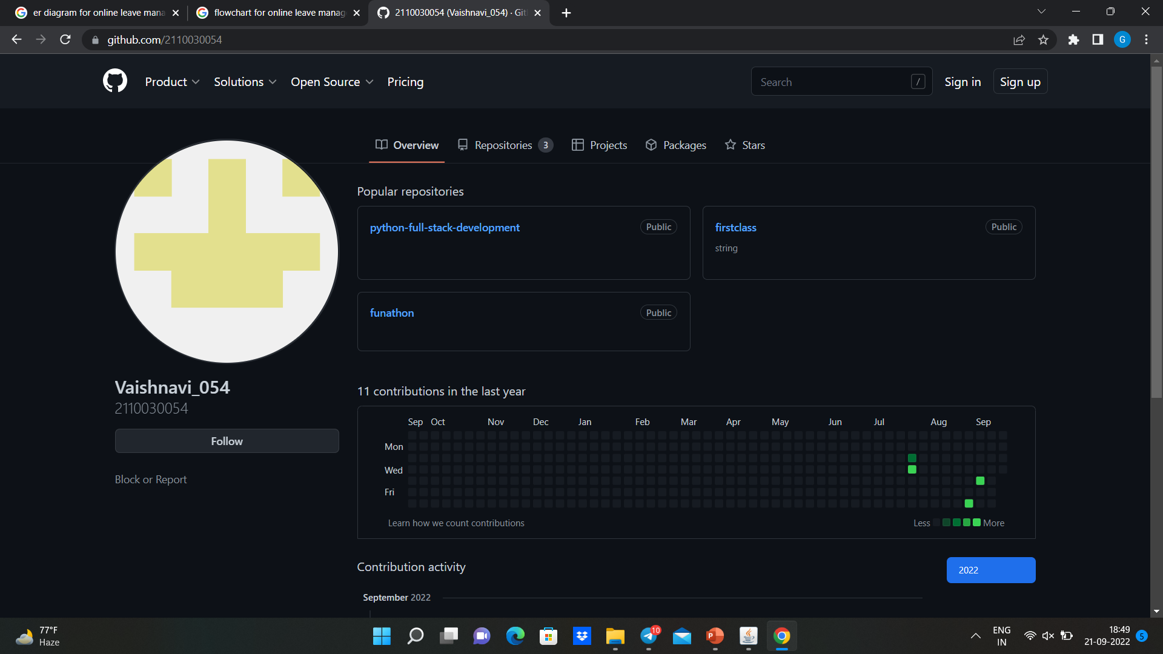
GITHUB SETUP

Slide 14
Thank You

